Slide 1
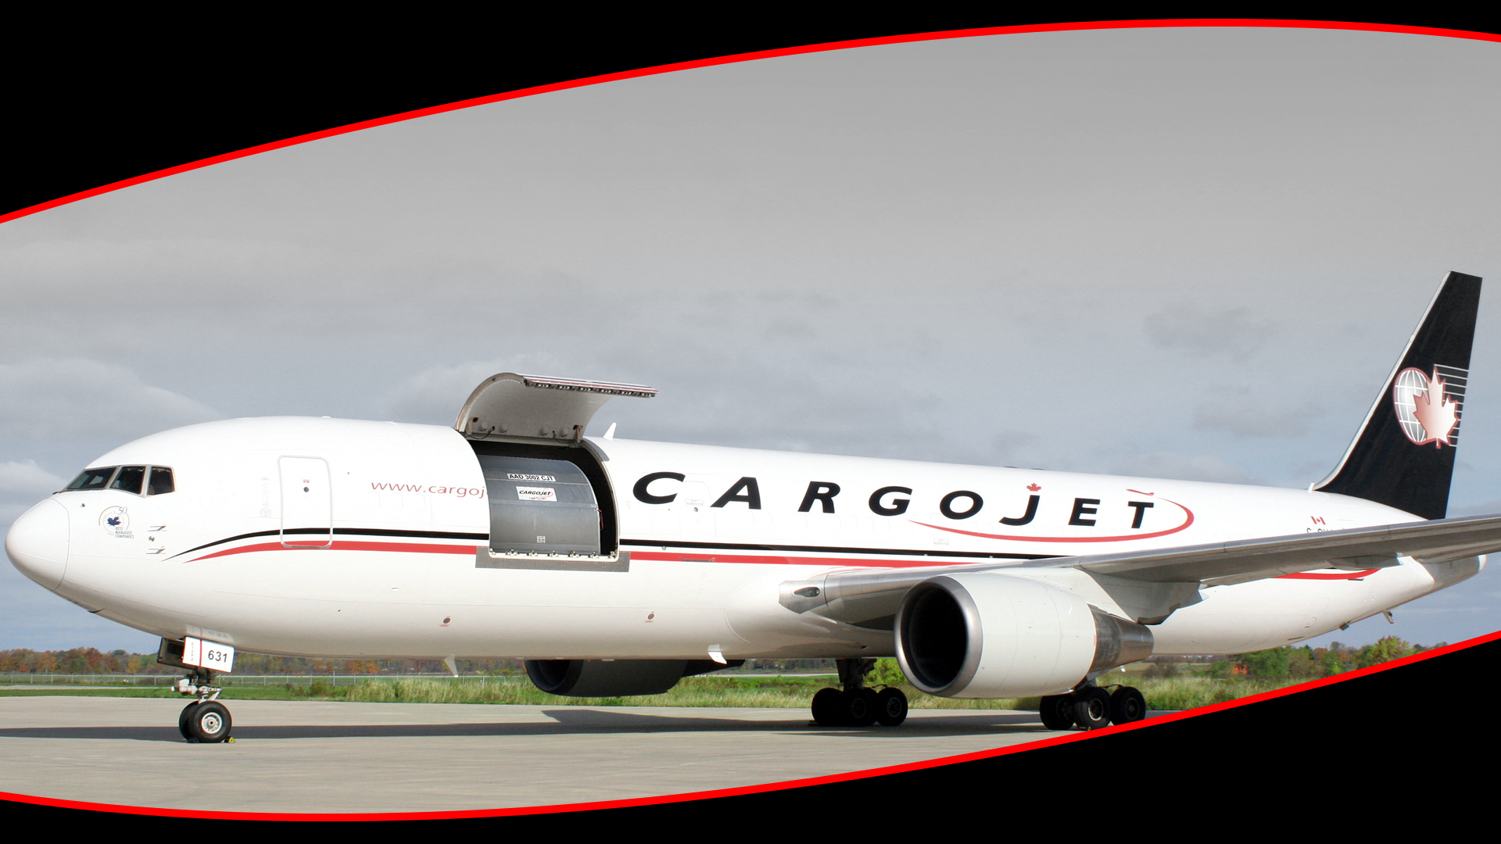

Corporate Overview
May 3 2022

Slide 2



Caution Concerning Forward Looking Statements
This presentation includes certain forward-looking statements that are based upon current expectations which involve risks and uncertainties associated with our business and the environment in which the business operates. Any statements contained herein that are not statements of historical facts may be deemed to be forward-looking statements including those identified by the expressions “anticipate”, “believe”, “plan”, “estimate”, “expect”, “intend”, “project” and similar expressions to the extent they relate to the Company or its management. The forward-looking statements are not historical facts, but reflect Cargojet’s current expectations regarding future results or events. These forward-looking statements are subject to a number of risks and uncertainties that could cause actual results or events to differ materially from current expectations. Examples of the factors that can affect the results are government regulations, competition, seasonal fluctuations, international trade, weather patterns, retention of key personnel, labour relations, terrorist activity, general industry condition and economic sensitivity, the Company’s ability to manage growth and profitability, fuel prices, other cost controls and foreign exchange fluctuations, and capability of maintaining its fleet. The risk and uncertainties are detailed in the “Risk Factors” section of the MD&A for the three month period and the year ended December 31, 2020 dated March 1, 2021 which was filed with SEDAR at www.sedar.com and the Company is not aware of any significant changes to its risk factors from those disclosed at that time.
Forward looking statements are based on a number of material factors, expectations or assumptions of the Company which have been used to develop such statements and information but which may prove to be incorrect. Although the Company believes that the expectations reflected in such forward-looking statements or information are reasonable, undue reliance should not be placed on forward-looking statements because the Company can give no assurance that such expectations will prove to be correct. The statements are based on the following factors: the continued and timely development of infrastructure, continued availability of debt financing and cash flow, future commodity prices, currency, exchange and interest rates, regulatory framework regarding taxes and environmental matters in the jurisdictions in which the Company operates.
This document contains forward-looking statements that reflect management’s current expectations related to matters such as future financial performance and liquidity and capital resources of the Company.

Slide 3

Agenda
Who we Are
Business Model
Ambition and Strategy
Key Market Segments
Domestic Business
ACMI Business
Adhoc Charter Business
Fleet Plan
Financial Highlights
Business Outlook
Reference Material

Slide 4

Who We Are
Entrepreneurial company that prides itself in building lasting customer relationships while delivering exceptional service
Engaged and passionate workforce of over 1,500 with over $750 million in revenues
In 20 years, we have become Canada’s #1 cargo airline, only national overnight air cargo consolidator
We represent over 90% of the domestic overnight air cargo lift available in Canada

Slide 5

Business Model
Only national network that enables next day service for courier industry to over 90% of Canadian population, a strong competitive advantage
Entrepreneurial mindset: allows speed to market, responsiveness and sharp focus on network optimization and cost management
Long-term customer contracts: with minimum revenue guarantees and cost pass-through provisions for increases in uncontrollable variable costs (e.g. fuel)
Unique mix of customers & cargo: allows optimization of density and space
Fuel efficient fleet: state-of-the-art aircraft & GSE equipment
Barriers to entry: serving 16 major airports in Canada stretching across Canada from coast to coast (eg. St. John’s - Iqaluit - Vancouver)
Strong, motivated non-unionized workforce – High level of engagement
Pilots union enjoys a very positive and collaborative relationship; 7-year contract extended in 2019 to June 2027. The contract contains a no-strike, no-lockout clause

Slide 6

Ambition and Strategy - Pillars
Build the most efficient “middle-mile” air capability to allow couriers and logistics players to fulfil their time-sensitive “next-day” delivery promise.
Identify high growth areas and aggressively pursue opportunities that allow network and fleet optimization thereby creating attractive price-points for customers to use more air product.
Play a key role in enabling e-commerce growth across North America by understanding and fulfilling emerging requirements from e-Commerce and logistics players.

Slide 7

Ambition and Strategy - Tactics
Maintain e-Commerce leadership (B2B and B2C)
  Backbone for all time-sensitive deliveries across Canada for all major logistics and courier players
  Cargojet is the de-facto enabler of e-commerce in Canada
  Cargojet reaches 90% of Canadian population through its overnight national network to fulfil next day delivery promise.
Capture new cross-border and international opportunities
  Growing ACMI services for international courier customers
  Stronger demand and yields on international adhoc charters due to the shortage of air cargo capacity due to the lack of passenger air cargo capacity

Slide 8

Ambition and Strategy - Tactics
Continue to optimize fleet utilization by building both day and week-end networks including Charters and ACMI model.
Opportunistically utilize west-to-east lanes for non-courier freight opportunities (Asia inbound) and E-commerce growth.
Exploit adjacent revenue opportunities by offering ground-handling capabilities to third party shippers.
Build the best fleet to allow cost advantage for our customers.
Attract and retain the best talent and maintain high employee engagement of frontline staff .
Build a cost-effective MRO capability to capture additional margin opportunity.

Slide 9

Key Market Segments
We serve three key market segments:
Domestic Network (includes Surcharges, Interline and Newark/Bermuda route)
ACMI (Aircraft, Crew, Maintenance and Insurance) primarily dedicated scheduled routes
“All-in Charter” primarily adhoc business

Slide 10

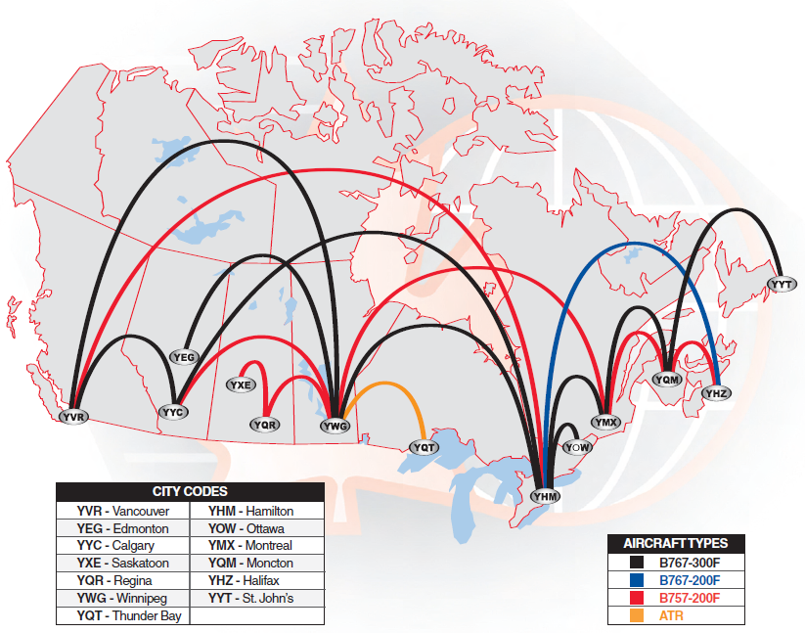
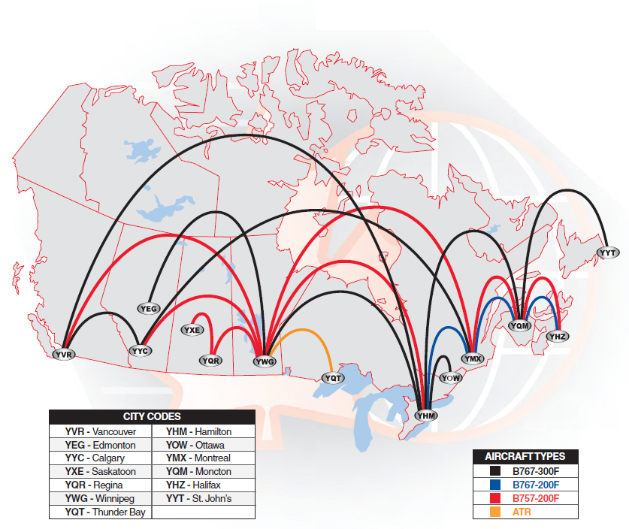
Domestic Business - Network
Cargojet operates its network across North America transporting Over 25 million pounds of time-sensitive cargo weekly
Westbound Flights
Eastbound Flights
Cargojet operates over 80 flight legs each business night using a combination of B767-300F; B767-200F and B757-200F aircraft

Slide 11

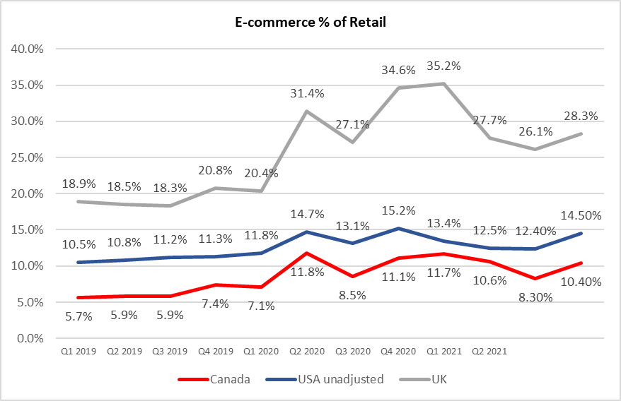
Domestic Business – the Growth of E-Commerce
Sources: Statistics Canada, US Census Bureau and the UK Office for National Statistics

Slide 12
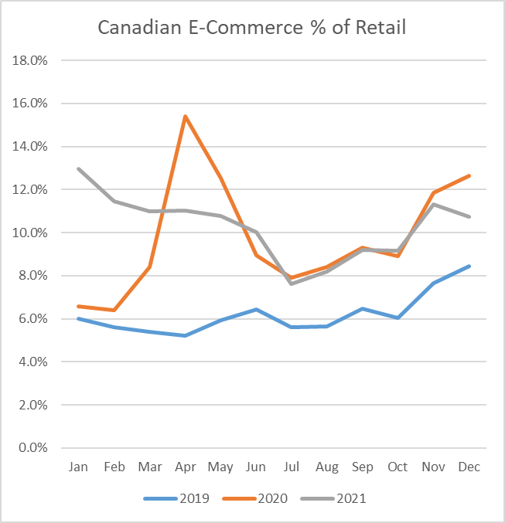
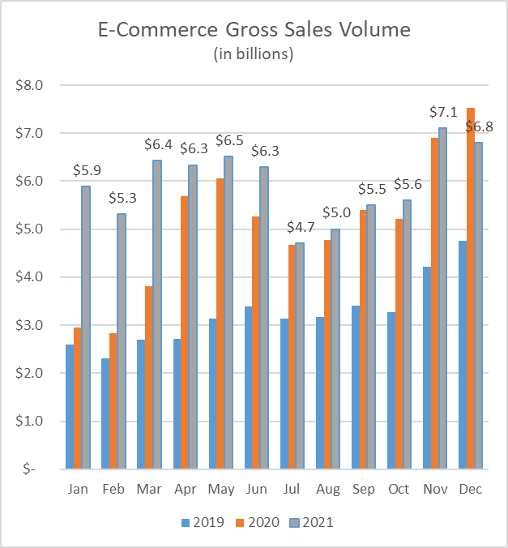
Growth of E-Commerce – Canada Only
E-Commerce Stats Source: Statistics Canada

Slide 13



Domestic Business - Customers
Approx. 75% of Domestic Revenues are under long-term contracts
All contract include variable surcharges for uncontrollable cost changes (e.g. fuel and regulatory changes)
All contracts have guaranteed volume minimums
All contracts have CPI-based automatic annual price increases

Slide 14

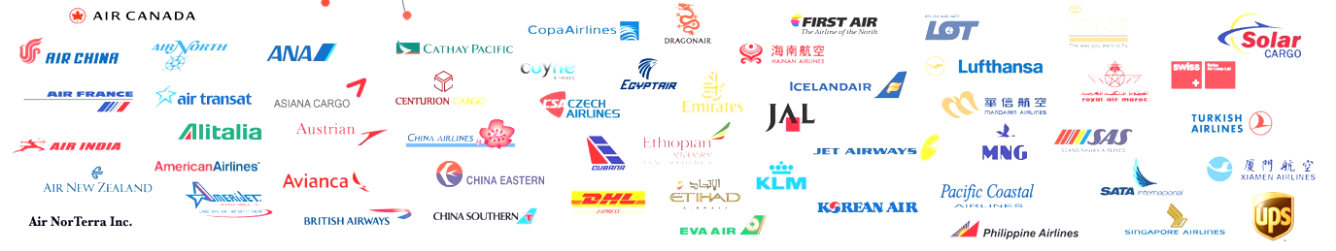
Domestic Business - Alliances
Fifty-Four international Alliances/Partnerships with the world’s leading carriers
Allows these carriers to extend their networks
Expands Cargojet’s brand globally

Slide 15

Domestic Business- OTP
Cargojet must demonstrate operational excellence each and every night to maintain industry leading on-time performance;
Cargojet is ISO 9001-2008 and IATA Operational Safety Audit (IOSA) certified;
Safety, Reliability and Efficiency are the essential values of Cargojet’s business.

Slide 16
ACMI Business
Cargojet currently operates 12 dedicated ACMI routes for DHL:
  4 Cross-Border Routes between DHL’s hub at CVG airport and major airports in Canada
  3 Routes that operate between airports in Mexico and CVG. The most recent route started at the end of Q3 2020.
  3 New Routes that operate between CVG and the UK and YHM and UK that started in April 2020 and October 2021 respectively
  2 New Routes that operate between YHM - YYC and YHM – YVR
Each route requires an aircraft since the DHL network operates concurrently with Cargojet’s Domestic Network

Slide 17
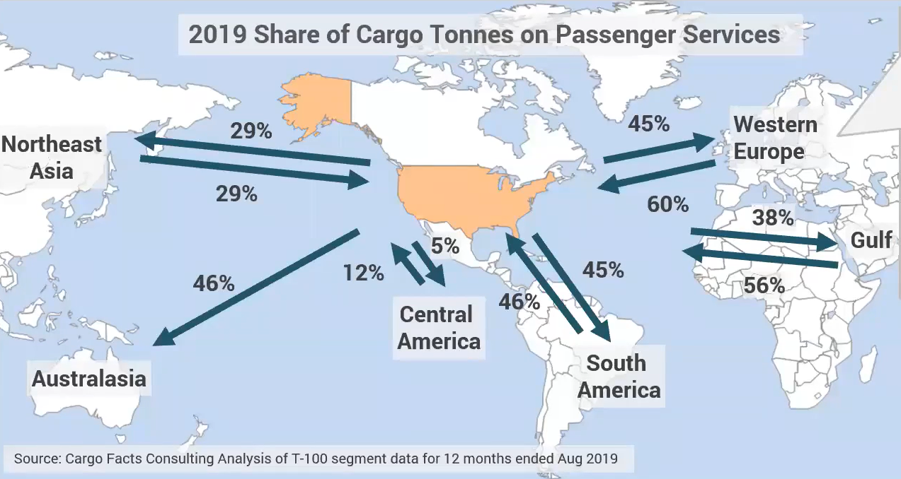
Adhoc Charter Business
Cargojet utilizes the same aircraft that operate in its Domestic and ACMI networks on weekends and daytime for Adhoc charters and scheduled some charters on weekends.
Cargojet is competitive in the adhoc market due to the fact that its fixed costs are already covered by its Domestic and ACMI businesses.
International Adhoc charter rates and demand have surged due to the lack of air cargo capacity caused by the grounding of aircraft due to Covid-19
Adhoc charter rates and demand for Cargojet’s services are expected to remain strong until the passenger industry recovers.

Slide 18
Fleet Plan
All-cargo aircraft operated by Cargojet
Type | Payload (lbs) | 2019 | 2020 | 2021 | 2022 Plan | 2023 Proj. | 2024 Proj.
B767-300 | 125,000 | 12 | 14 | 16 | 19 | 20 | 20
B767-200 | 100,000 | 1 | 3 | 3 | 3 | 3 | 4
B757-200 | 80,000 | 8 | 8 | 9 | 14 | 15 | 15
B777-200 | 233,000 | - | - | - | - | 1 | 4
B777-300 | 222,000 | - | - | - | - | - | 2
Total |  | 21 | 25 | 28 | 36 | 39 | 45

Slide 19
Financial Highlights

Slide 20

Quarterly Revenue and Adjusted EBITDA
The Covid pandemic has resulted in a sharp increase in adhoc charter and ACMI demand.
Cargojet’s “Peak Season” in Q4 reflects the holiday shopping season beginning in late November.
The growth of e-commerce is the key driver of Domestic volume and revenue growth

Slide 21

Cargojet Has Achieved New Levels of Revenue & Cashflow
Cargojet’s revenues growth is driven by e-commerce and new ACMI routes flown between Canada, Europe, the US and Mexico.
The growth of e-commerce continues to drive Domestic and ACMI revenues.

Slide 22
Domestic Revenues
Domestic revenues have increased due to the CPGOC contract and tremendous e-commerce growth. Domestic revenues are net of contract amortization costs.
Surcharge revenues are comprised primarily of fuel surcharges from core customers that are 100% variable based on the price of fuel. Surcharges revenues also include amounts for navigation and pass-through costs for some ACMI charters.

Slide 23

ACMI and Adhoc Charter Revenues
Cargojet operates 12 ACMI routes between Canada, US and Mexico. An additional route to Europe and two domestic route were added in October 2021.
The increase in All-in Charter revenues in 2020 was due primarily to flights to China to supply Canadian governments with PPE
ACMI revenues produce a relatively high EBITDA margin since flight costs such as fuel, navigation charges, landing fees and ground handling charges are borne directly by the customer.

Slide 24
Market Cap & Stock Price
Cargojet was added to the TSX S&P index in 2019.
Notes:
Cargojet’s share price reflects the confidence in the Company’s ability to manage its costs and increase its profitability. Cargojet has promised to reduce its debt and grow its business

Slide 25
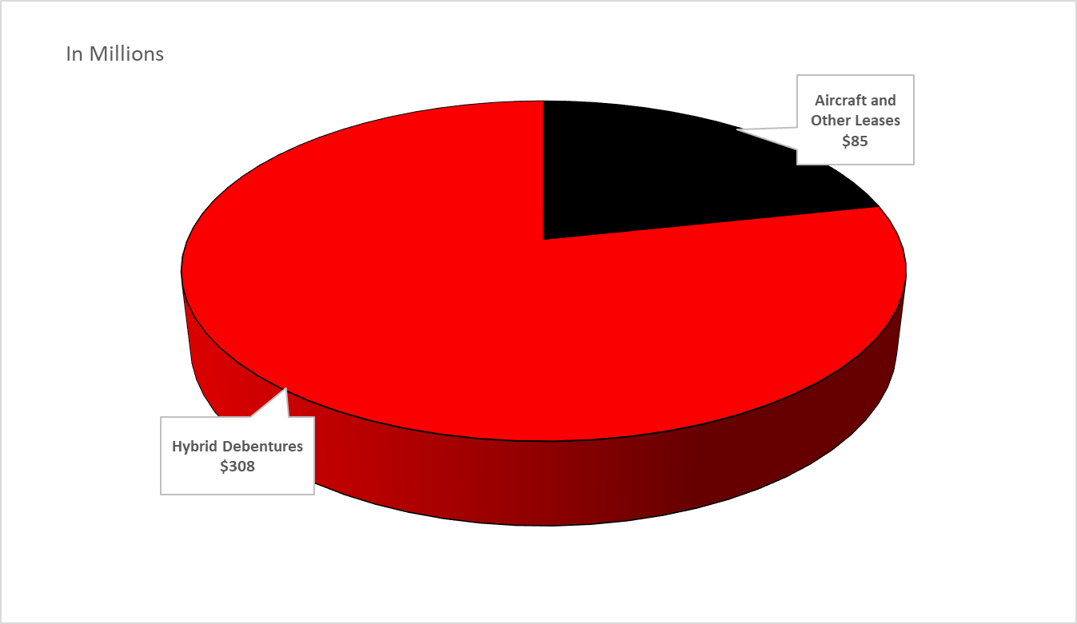
Cargojet Debt at March 31, 2021
Total debt is approx. 1.26x trailing 12-month Adjusted EBITDAR.
Cargojet amended Syndicated Revolver in February 2022 with borrowing limit of $600M with an additional $100M increase on request by Cargojet and approval by lenders and extended maturity date till February 2027.
Cargojet issued 1,713,500 shares for $365M in February 2021. Part of the net proceeds were used to pay down the Syndicated Revolver and aircraft leases.

Slide 26
Business Outlook
Long term customer contracts generate 75% of annual revenues with renewal options.
Highly engaged workforce with a strong safety culture continues to be the backbone of our service offerings.
We are well positioned to benefit from long-term secular trends in e-commerce serving both B2C and B2B segments.
We continue to enhance our product offerings to increase asset utilization and margin enhancement:
  E-commerce demand has expanded the demand for air cargo services into the weekend and daytime.
  New air cargo charter opportunities exist with wide-body aircraft fleet strategically located across the country and internationally.
Strong track record of revenue and EBITDA growth, cashflow generation and cost management.
Focus on capital structure to reduce debt in the medium term.

Slide 27
CARGOJET’s ESG POLICY

Slide 30
Reference Material

Slide 31

Air Cargo Industry Memberships
ISO 9001:2000 Quality Certified Company
International Air Transport Association
The International Air Cargo Association
Canadian Courier & Logistics Association

Slide 32

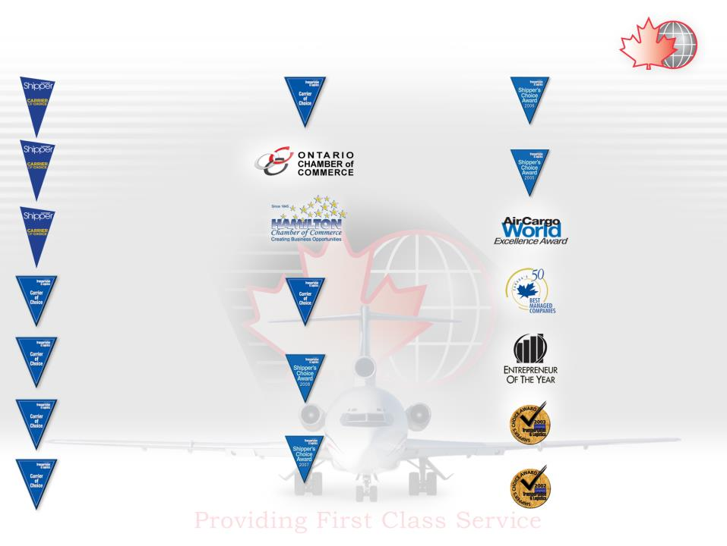

AWARDS
2010 - “Carrier of Choice” – Shipper’s Choice Award
– Cargojet awarded as Canada’s Cargo Airline and Carrier of Choice for 2010 by the Canadian Transportation and Logistics Magazine.
2006 - “Cargo Airline of the Year” – Shipper’s Choice Award – Cargojet awarded as Canada’s Cargo Airline of 2006 by the Canadian Transportation and Logistics Magazine.
2021 - “Carrier of Choice” – Shipper’s Choice Award
2019 - “Carrier of Choice” – Shipper’s Choice Award
2018 - “Carrier of Choice” – Shipper’s Choice Award
2009 - “Outstanding Business
Achievement Award, Ontario”
– awarded by the Ontario Chamber
of Commerce.
2005 - “Cargo Airline of the Year” – Shipper’s Choice Award – Cargojet awarded as Canada’s Cargo Airline of 2005 by the Canadian Transportation and Logistics Magazine.
2017 - “Carrier of Choice” – Shipper’s Choice Award
2016 - “Carrier of Choice” – Shipper’s Choice Award
2015 - “Carrier of Choice” – Shipper’s Choice Award – Cargojet awarded as Canada’s Cargo Airline and Carrier of Choice for 2015 by the Canadian Transportation and Logistics Magazine.
2009 - “Outstanding Business Achievement Award” – awarded by
the Hamilton Chamber of Commerce.
2005 - Cargojet has been awarded as “Leader In Customer Service”.
2014 - “Carrier of Choice” – Shipper’s Choice Award – Cargojet awarded as Canada’s Cargo Airline and Carrier of Choice for 2014 by the Canadian Transportation and Logistics Magazine.
2009 - “Carrier of Choice” – Shipper’s Choice Award – Cargojet awarded as Canada’s Cargo Airline and Carrier of Choice for 2009 by the Canadian Transportation and Logistics Magazine.
January 17, 2005 - Cargojet has been awarded one of Canada’s 50 Best Managed Companies, by Deloiite & Touche, National Post, CIBC Banking and Queens University.
2013 - “Carrier of Choice” – Shipper’s Choice Award – Cargojet awarded as Canada’s Cargo Airline and Carrier of Choice for 2013 by the Canadian Transportation and Logistics Magazine.
November 2004 - “Entrepreneur of the Year”
– Ajay K. Virmani named as
Entrepreneur of the Year by Ernst Young.
2008 - “Cargo Airline of the Year” – Shipper’s Choice Award – Cargojet awarded as Canada’s Cargo Airline of 2008 by the Canadian Transportation and Logistics Magazine.
2012 - “Carrier of Choice” – Shipper’s Choice Award
– Cargojet awarded as Canada’s Cargo Airline and Carrier of Choice for 2012 by the Canadian Transportation and Logistics Magazine.
September 2003 - “Cargo Airline of the Year”
– Shipper’s Choice Award – Cargojet awarded as Canada’s Cargo Airline of 2003 by the Canadian Transportation and Logistics Magazine.
2007 - “Cargo Airline of the Year” – Shipper’s Choice Award – Cargojet awarded as Canada’s Cargo Airline of 2007 by the Canadian Transportation and Logistics Magazine.
2011 - “Carrier of Choice” – Shipper’s Choice Award
– Cargojet awarded as Canada’s Cargo Airline and Carrier of Choice for 2011 by the Canadian Transportation and Logistics Magazine.
September 2002 - “Cargo Airline of the Year”
– Shipper’s Choice Award – Cargojet awarded as Canada’s Cargo Airline of 2002 by the Canadian Transportation and Logistics Magazine.

Slide 33

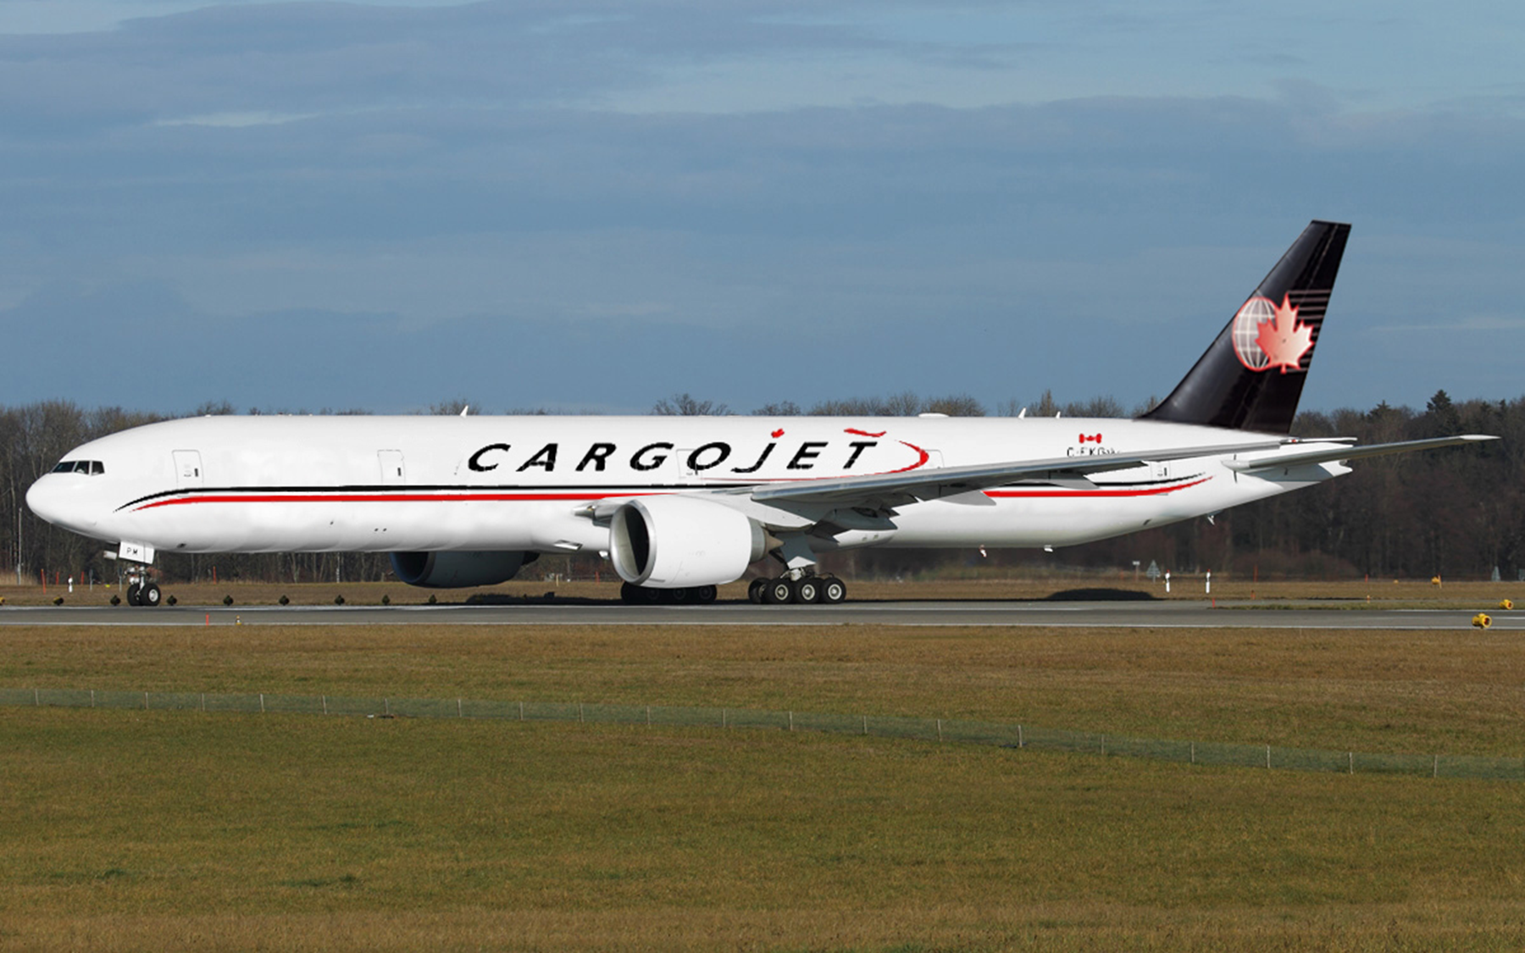
Boeing 777-200ERF
Maximum Payload: 233,000 lbs

Slide 34

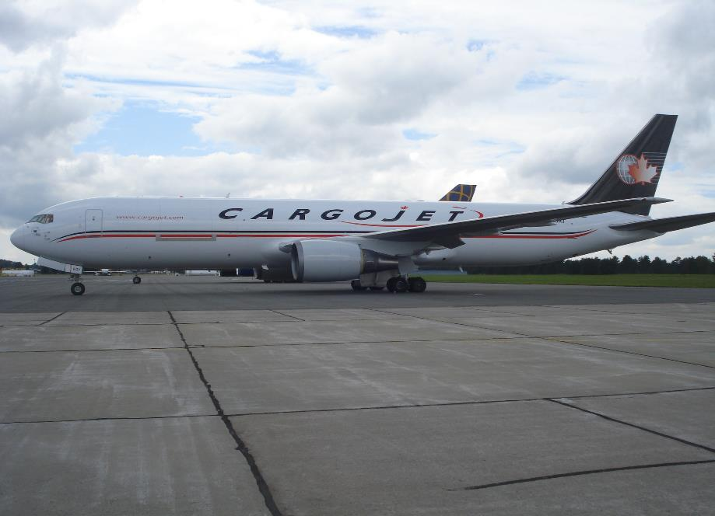
Boeing 767-300ERF
Maximum Payload: 125,000 lbs

Slide 35
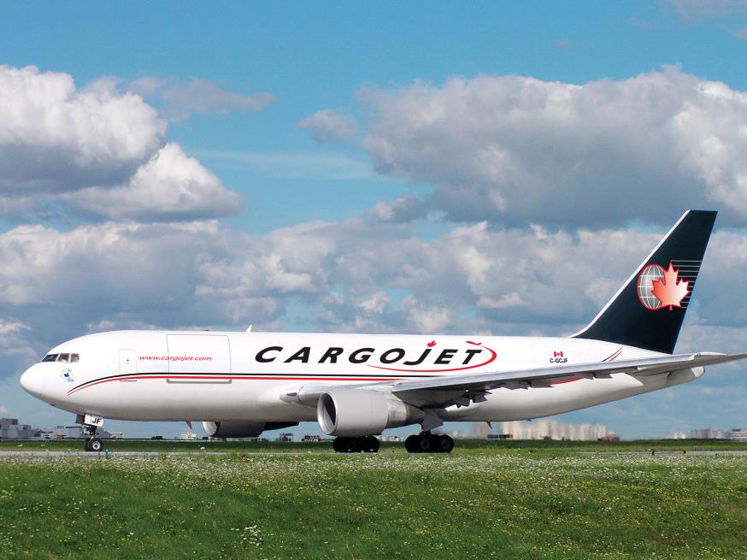
Boeing 767-200ERF
Maximum Payload: 100,000 lbs

Slide 36
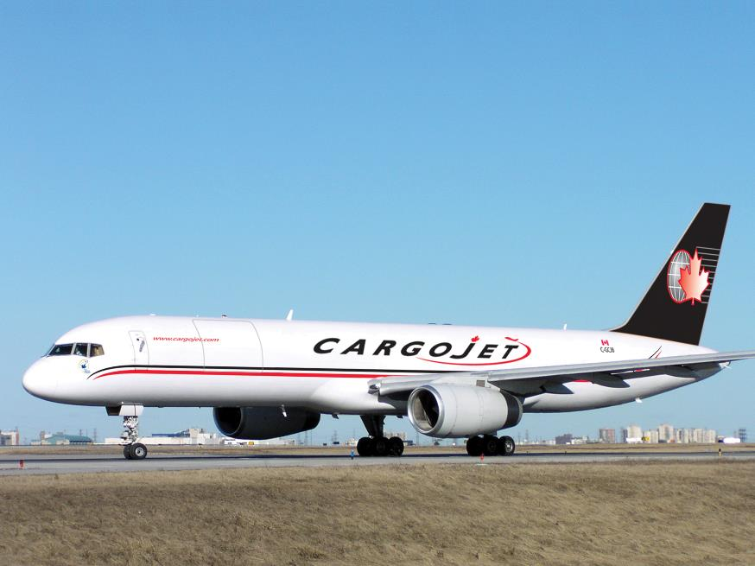
Boeing 757-200ER
Maximum Payload: 80,000 lbs

Slide 37
Thank You.

